Slide 1
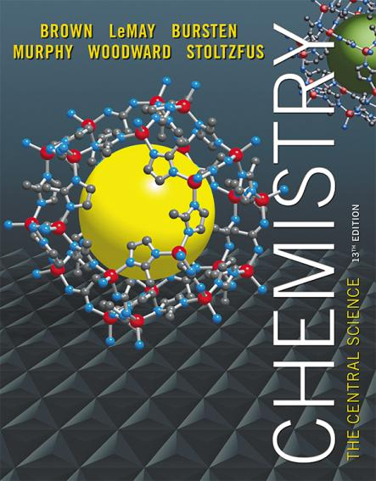
Lecture Presentation
Chapter 7 Periodic Properties of the Elements

Slide 2
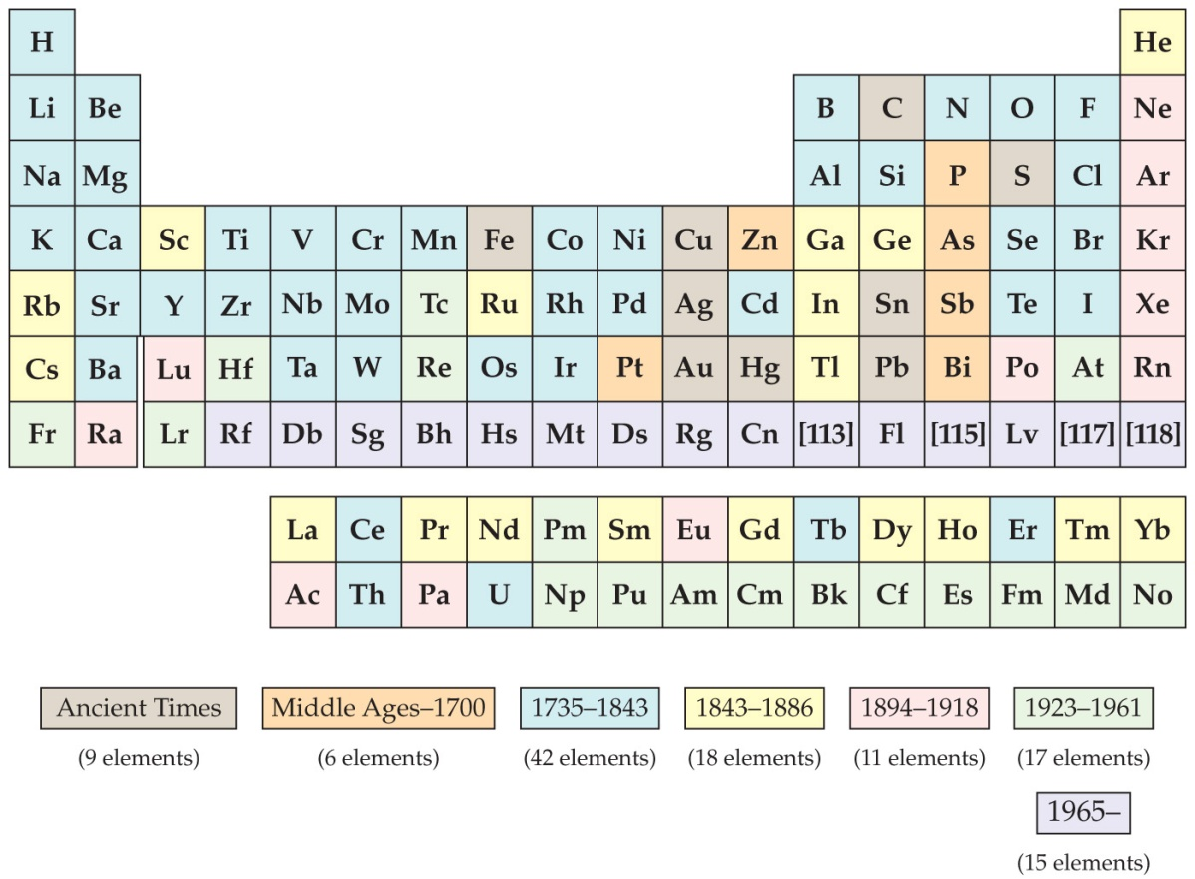
Development of the Periodic Table
Dmitri Mendeleev and Lothar Meyer independently came to the same conclusion about how elements should be grouped.

Slide 3
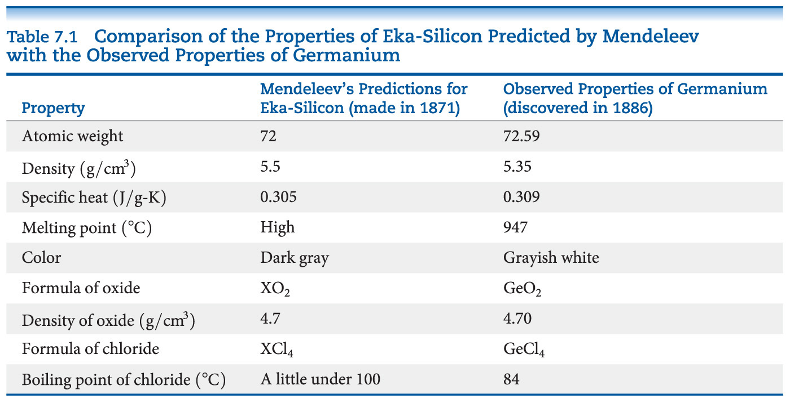
Mendeleev and the Periodic Table
Chemists mostly credit Mendeleev because he also used chemical properties to organize the table and predicted some missing elements and their expected properties, including germanium.

Slide 4
Atomic Number
Mendeleev’s table was based on atomic masses. It was the most fundamental property of elements known at the time.
About 35 years later, the nuclear atom was discovered by Ernest Rutherford.
Henry Moseley developed the concept of atomic number experimentally. The number of protons was considered the basis for the periodic property of elements.

Slide 5
Periodicity
Periodicity is the repetitive pattern of a property for elements based on atomic number.
The following properties are discussed in this chapter:
Sizes of atoms and ions
Ionization energy
Electron affinity
Some group chemical property trends
First, we will discuss a fundamental property that leads to may of the trends, effective nuclear charge.

Slide 6
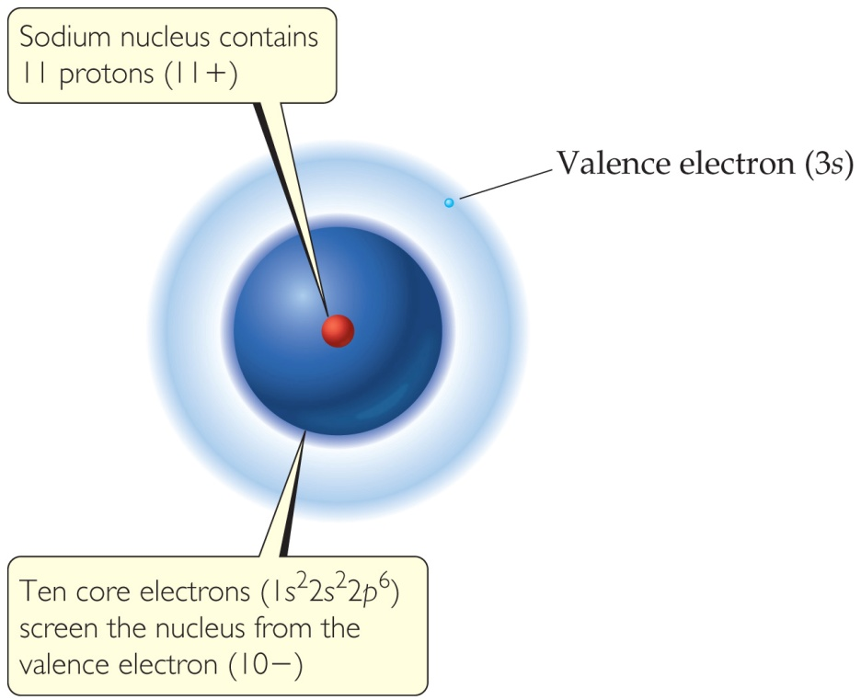
Effective Nuclear Charge
Many properties depend on attractions between valence electrons and the nucleus.
Electrons are both attracted to the nucleus and repelled by other electrons.
The forces an electron experiences depend on both factors.

Slide 7
Effective Nuclear Charge
The effective nuclear charge, Z_{eff}, is found this way:
Z_{eff} = Z − S
where Z is the atomic number and S is a screening constant, usually close to the number of inner electrons.
Effective nuclear charge is a periodic property:
It increases across a period.
It decreases down a group.

Slide 8

Screening effect
e-
Valence electron
Core electrons
(screen)

Slide 9
Zeff
Na [Ne]3s¹; Z = 11+
Zeff = 11 – 10 = 1
The situation became more complicated if electron in what type of orbital is considered
For 3s electron in Na, it has smaller probability of being closer to the nucleus
Zeff = 11 – 8.5 = 2.5 +

Slide 10
ENC
For many-electron atom, the energies of orbitals with same n value increases with l value
For example in carbon, a 2s electron is not screened as much be the core orbital as is a 2p electron.
2s electron is lower in energy than the 2p electron

Slide 11
Effective Nuclear Charge
The ENC felt by outermost electrons is smaller that that felt by inner electron because of screening effect by the inner electrons
The big drop (Ne-Na): core electrons are more effective than the valence electrons at screening the nuclear charge

Slide 12
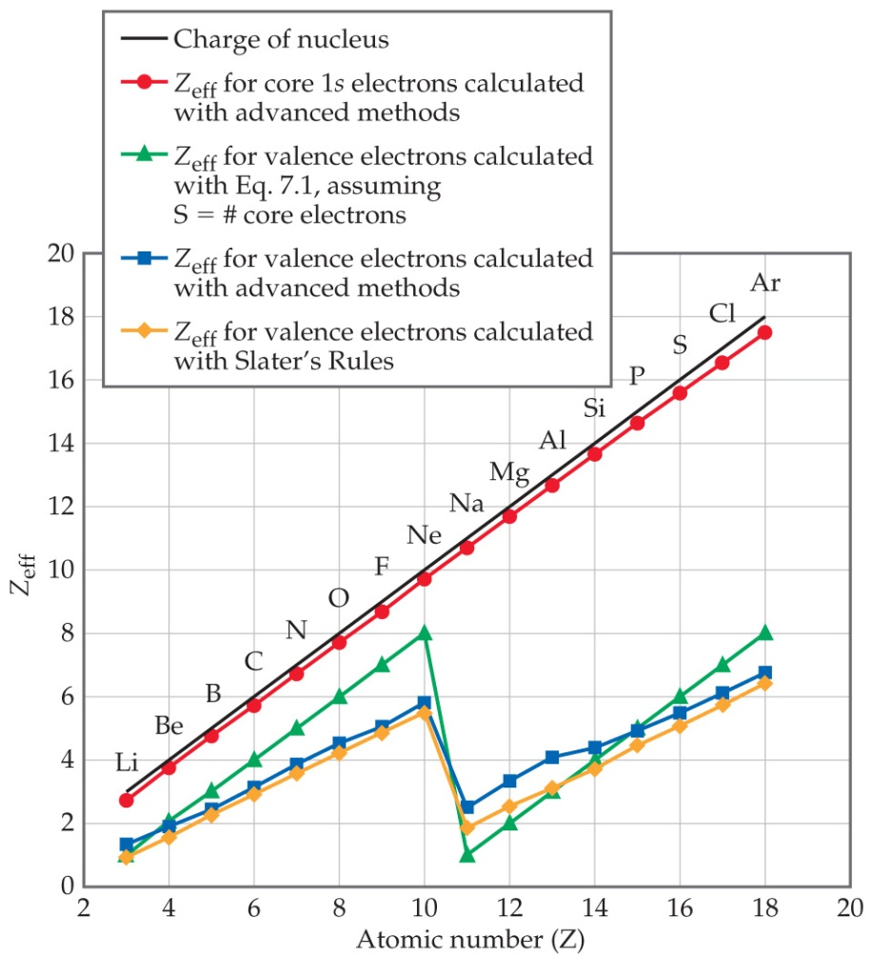
Effective Nuclear Charge Increases across a Period

Slide 13
S (Screening constant)
Zeff = Z – S (each e- contributes 1.00)
Calculation by Slater rule (see textbook p. 300)
E.g Fluorine
Calculation by Slater’s rule Zeff =9 - 3.8 = 5.2+
Calculation by Zeff = 9- 2 =7

Slide 14
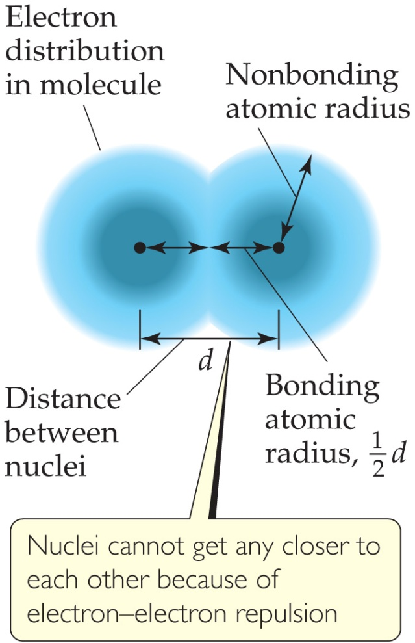
What Is the Size of an Atom?
The nonbonding atomic radius or van der Waals radius is half of the shortest distance separating two nuclei during a collision of atoms.

Slide 15
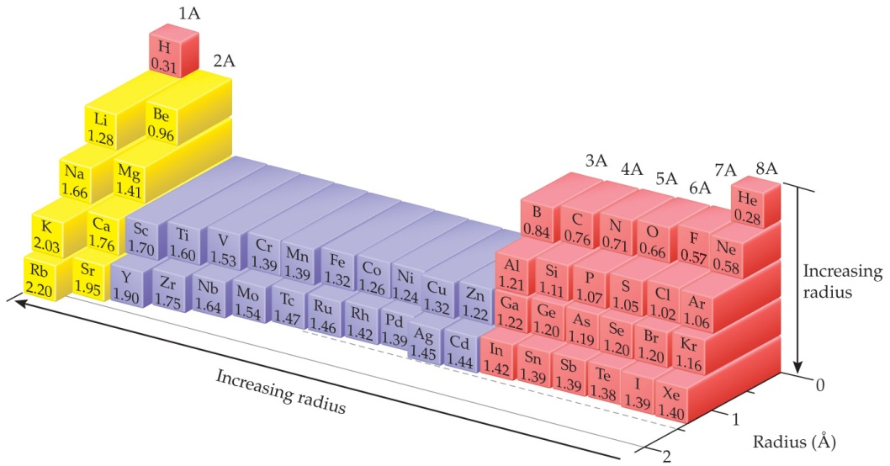
Sizes of Atoms
The bonding atomic radius is half the internuclear distance when atoms are bonded.
The bonding atomic radius tends to
— decrease from left to right across a period (Z_{eff} ↑).
— increase from top to bottom of a group (n ↑).

Slide 16
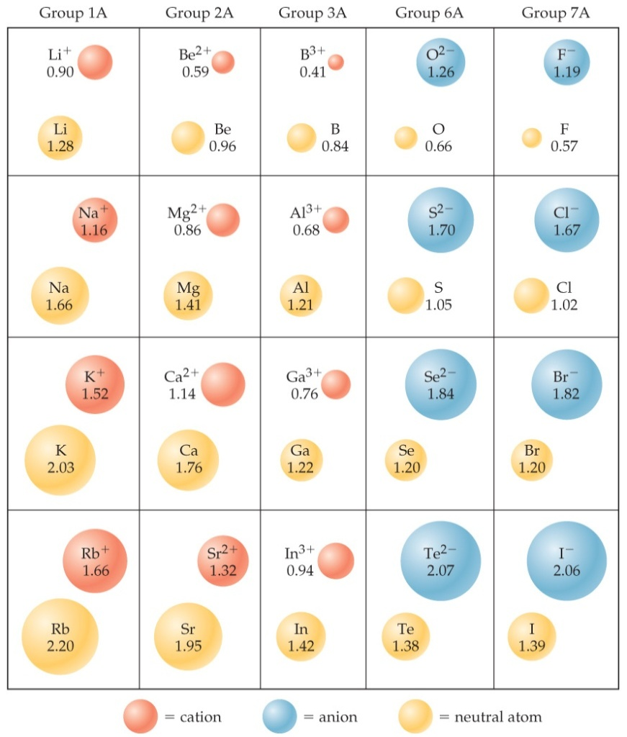
Sizes of Ions
Determined by interatomic distances in ionic compounds
Ionic size depends on
the nuclear charge.
the number of electrons.
the orbitals in which electrons reside.

Slide 17
Sizes of Ions
Cations are smaller than their parent atoms:
The outermost electron is removed and repulsions between electrons are reduced.
Anions are larger than their parent atoms:
Electrons are added and repulsions between electrons are increased.

Slide 18
Size of Ions— Isoelectronic Series
In an isoelectronic series, ions have the same number of electrons.
Ionic size decreases with an increasing nuclear charge.
An Isoelectronic Series (10 electrons)
Note increasing nuclear charge with decreasing ionic radius as atomic number increases
O^{2–} | F– | Na⁺ | Mg²⁺ | Al³⁺
1.26 Å | 1.19 Å | 1.16 Å | 0.86 Å | 0.68 Å

Slide 19
Ionization Energy (I)
The ionization energy is the minimum energy required to remove an electron from the ground state of a gaseous atom or ion.
The first ionization energy is that energy required to remove the first electron.
The second ionization energy is that energy required to remove the second electron, etc.
Note: the higher the ionization energy, the more difficult it is to remove an electron!

Slide 20
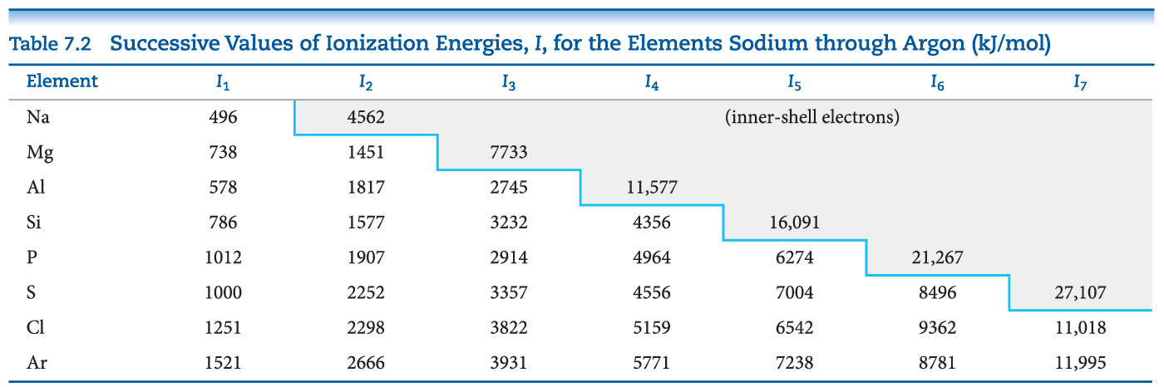
Ionization Energy
It requires more energy to remove each successive electron.
When all valence electrons have been removed, it takes a great deal more energy to remove the next electron.

Slide 21
Periodic Trends in First Ionization Energy (I₁)
I₁ generally increases across a period.
I₁ generally decreases down a group.
The s- and p-block elements show a larger range of values for I₁. (The d-block generally increases slowly across the period; the f-block elements show only small variations.)

Slide 22
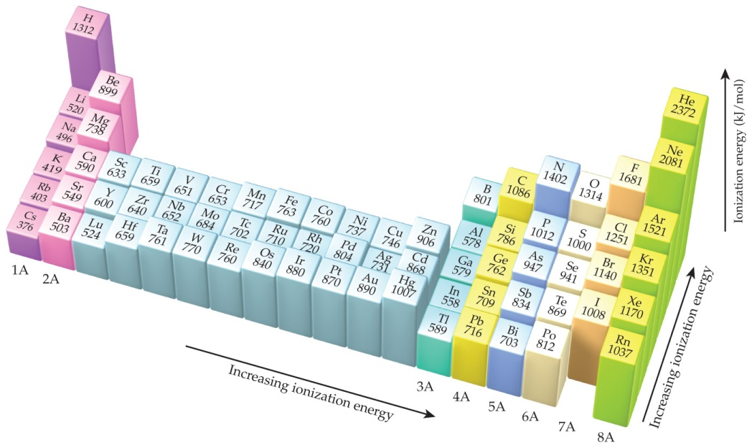
Factors that Influence Ionization Energy
Smaller atoms have higher I values.
I values depend on effective nuclear charge and average distance of the electron from the nucleus.

Slide 23
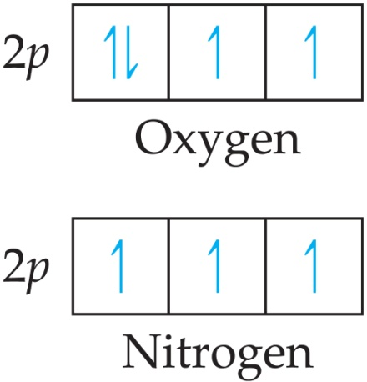
Irregularities in the General Trend
The trend is not followed when the added valence electron in the next element
enters a new sublevel (higher energy sublevel);
is the first electron to pair in one orbital of the sublevel (electron repulsions lower energy).

Slide 24
Electron Configurations of Ions
Cations: The electrons are lost from the highest energy level (n value).
Li⁺ is 1s² (losing a 2s electron).
Fe²⁺ is 1s²2s²2p⁶3s²3p⁶3d⁶ (losing two 4s electrons).
Anions: The electron configurations are filled to ns²np⁶; e.g., F– is 1s²2s²2p⁶ (gaining one electron in 2p).

Slide 25
Electron Affinity
Electron affinity is the energy change accompanying the addition of an electron to a gaseous atom:
Cl + e⁻ ⎯⎯→ Cl⁻
It is typically exothermic, so, for most elements, it is negative!

Slide 26
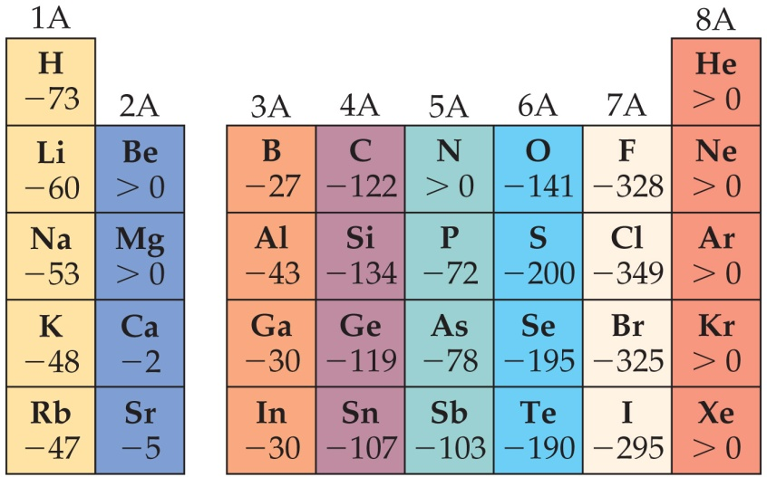
General Trend in Electron Affinity
Not much change in a group.
Across a period, it generally increases. Three notable exceptions include the following:
Group 2A: s sublevel is full!
Group 5A: p sublevel is half-full!
Group 8A: p sublevel is full!
Note: the electron affinity for many of these elements is positive (X– is unstable).

Slide 27
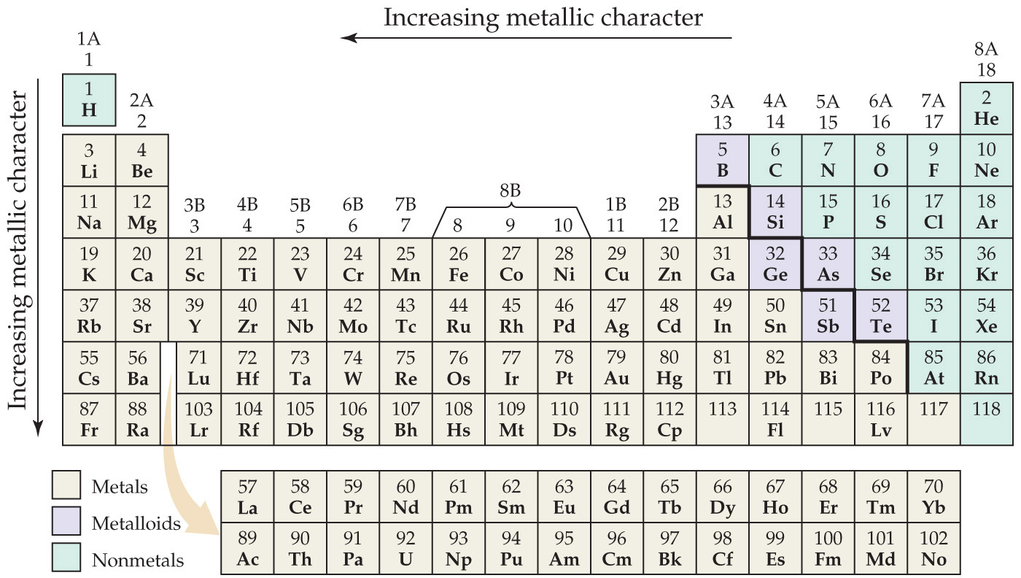
Metal, Nonmetals, and Metalloids

Slide 28
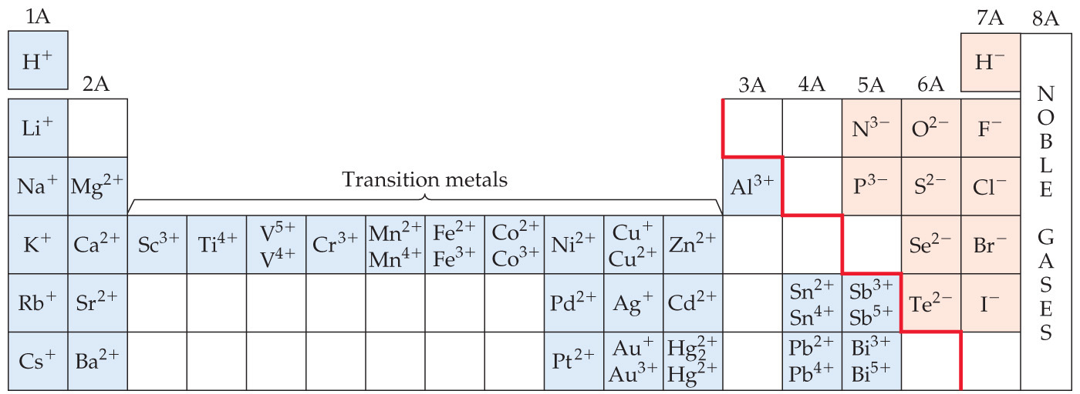
Metals Differ from Nonmetals
Metals tend to form cations.
Nonmetals tend to form anions.

Slide 29
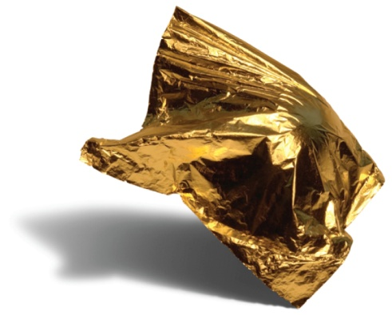
Metals
Most of the elements in nature are metals.
Properties of metals:
Shiny luster
Conduct heat and electricity
Malleable and ductile
Solids at room temperature (except mercury)
Low ionization energies/form cations easily

Slide 30
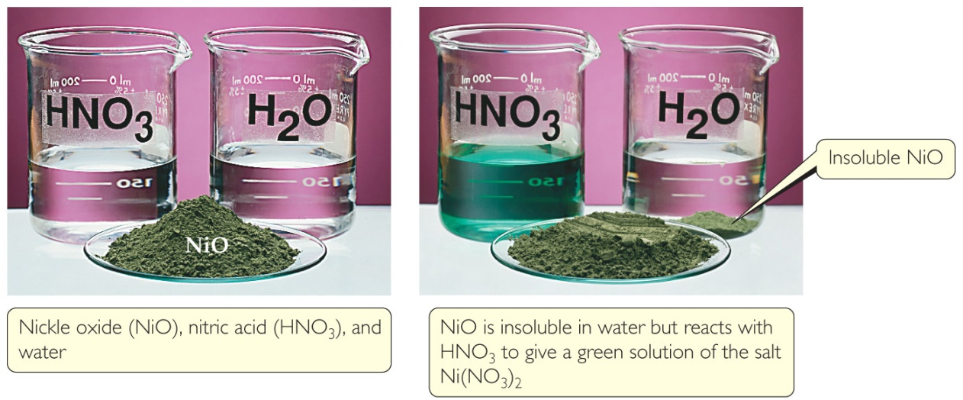
Metal Chemistry
Compounds formed between metals and nonmetals tend to be ionic.
Metal oxides tend to be basic.

Slide 31
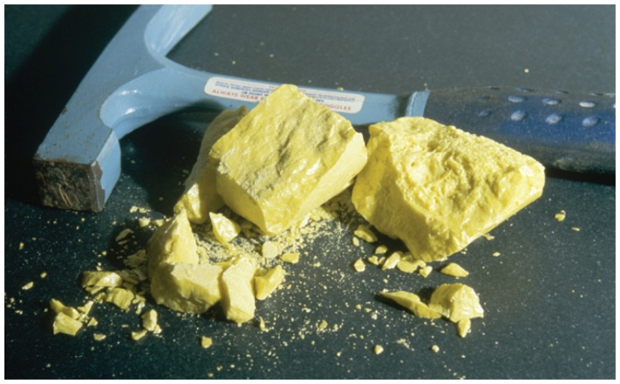
Nonmetals
Nonmetals are found on the right hand side of the periodic table.
Properties of nonmetals include the following:
Solid, liquid, or gas (depends on element)
Solids are dull, brittle, poor conductors
Large negative electronegativity/form anions readily

Slide 32
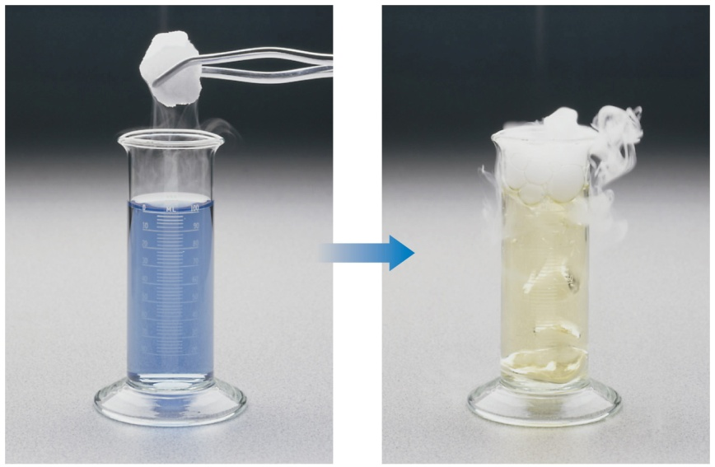
Nonmetal Chemistry
Substances containing only nonmetals are molecular compounds.
Most nonmetal oxides are acidic.

Slide 33
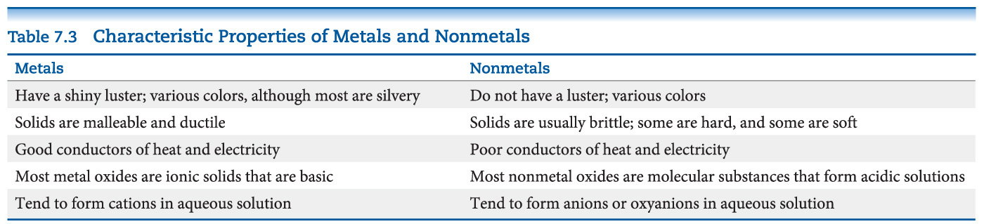
Recap of a Comparison of the Properties of Metals and Nonmetals

Slide 34
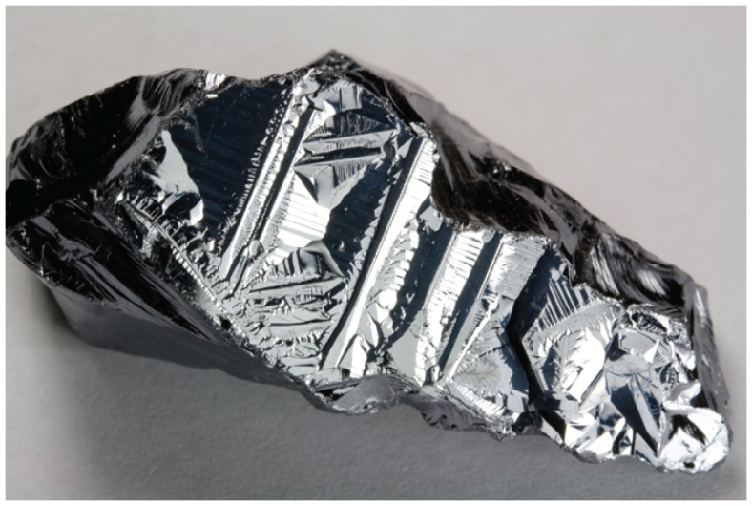
Metalloids
Metalloids have some characteristics of metals and some of nonmetals.
Several metalloids are electrical semiconductors (computer chips).

Slide 35
Group Trends
Elements in a group have similar properties.
Trends also exist within groups.
Groups Compared:
Group 1A: The Alkali Metals
Group 2A: The Alkaline Earth Metals
Group 6A: The Oxygen Group
Group 7A: The Halogens
Group 8A: The Noble Gases

Slide 36

Alkali Metals
Alkali metals are soft, metallic solids.
They are found only in compounds in nature, not in their elemental forms.
Typical metallic properties (luster, conductivity) are seen in them.

Slide 37
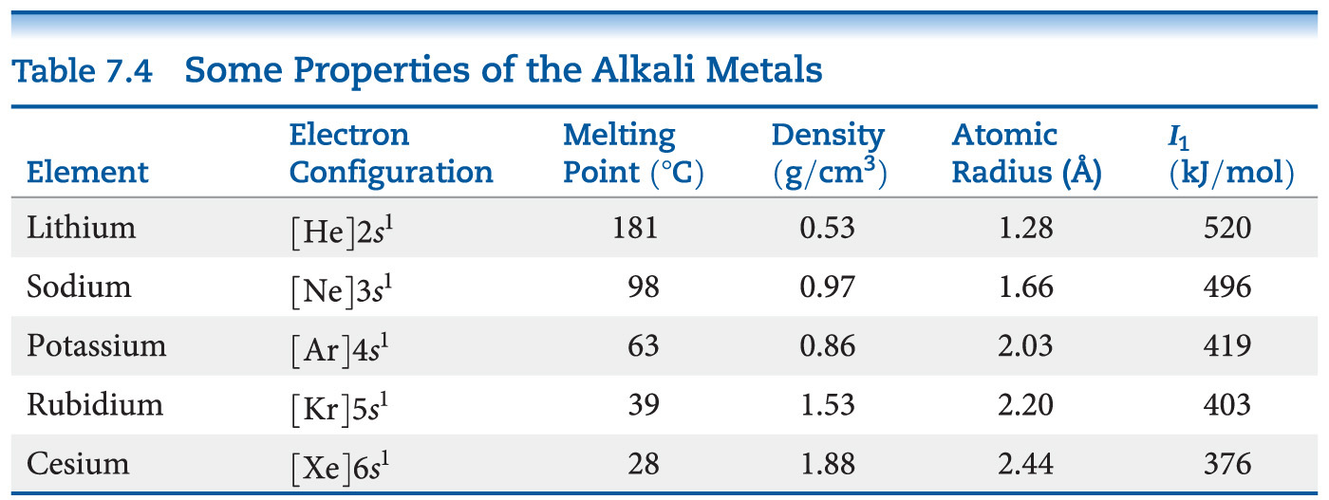
Alkali Metal Properties
They have low densities and melting points.
They also have low ionization energies.

Slide 38
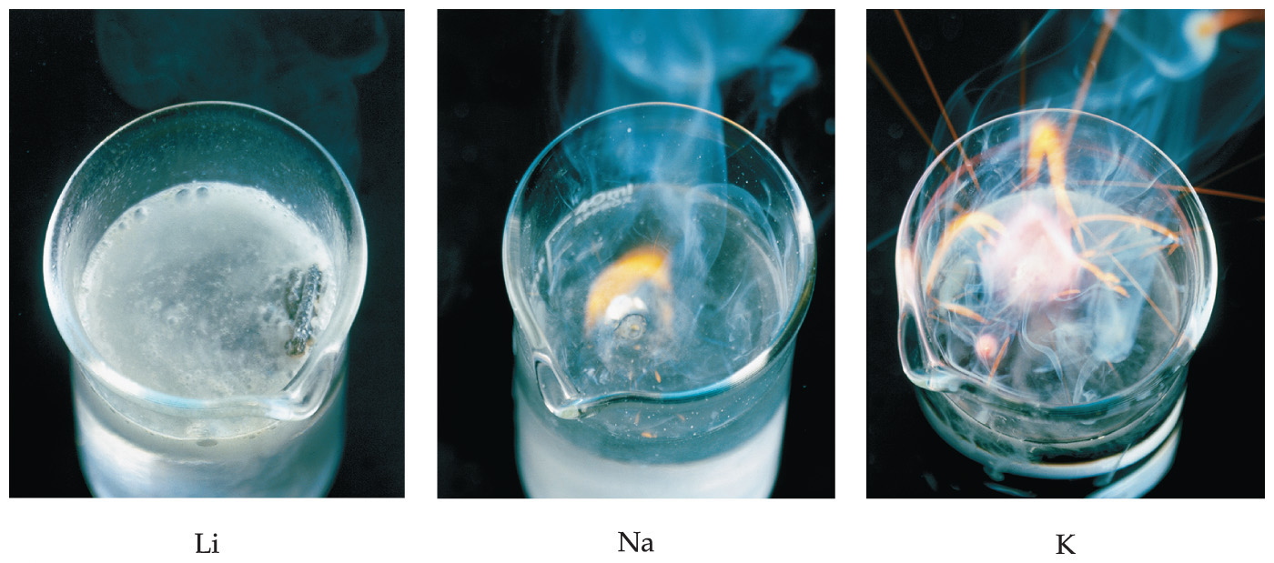
Alkali Metal Chemistry
Their reactions with water are famously exothermic.

Slide 39
Differences in Alkali Metal Chemistry
Lithium reacts with oxygen to make an oxide:
4 Li + O₂ ⎯⎯→ 2 Li₂O
Sodium reacts with oxygen to form a peroxide:
2 Na + O₂ ⎯⎯→ Na₂O₂
K, Rb, and Cs also form superoxides:
M + O₂ ⎯⎯→ MO₂

Slide 40
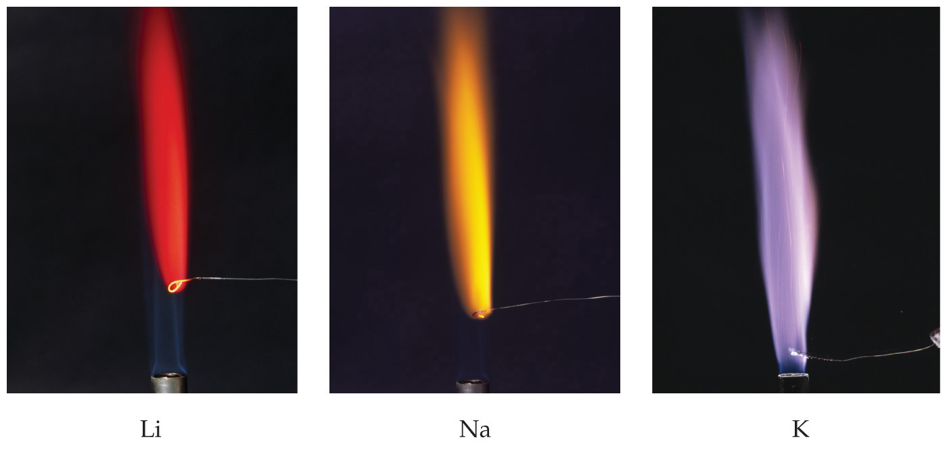
Flame Tests
Qualitative tests for alkali metals include their characteristic colors in flames.

Slide 41
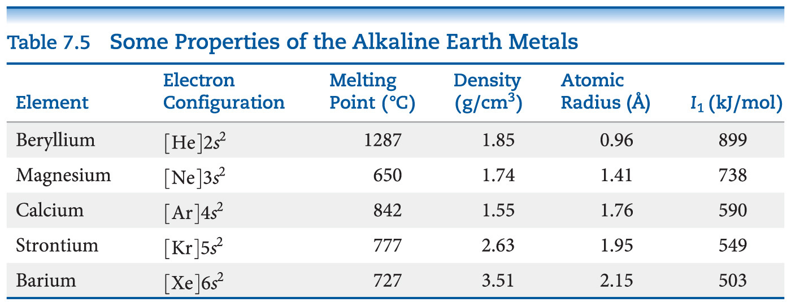
Alkaline Earth Metals—Compare to Alkali Metals
Alkaline earth metals have higher densities and melting points than alkali metals.
Their ionization energies are low, but not as low as those of alkali metals.

Slide 42
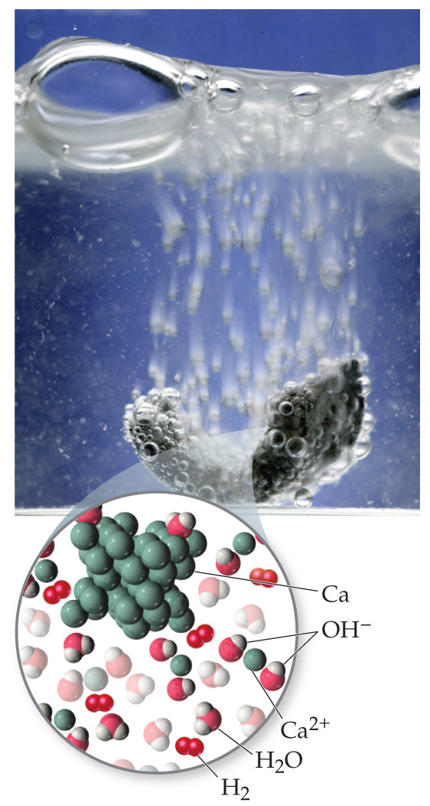
Alkaline Earth Metals
Beryllium does not react with water, and magnesium reacts only with steam, but the other alkaline earth metals react readily with water.
Reactivity tends to increase as you go down the group.

Slide 43
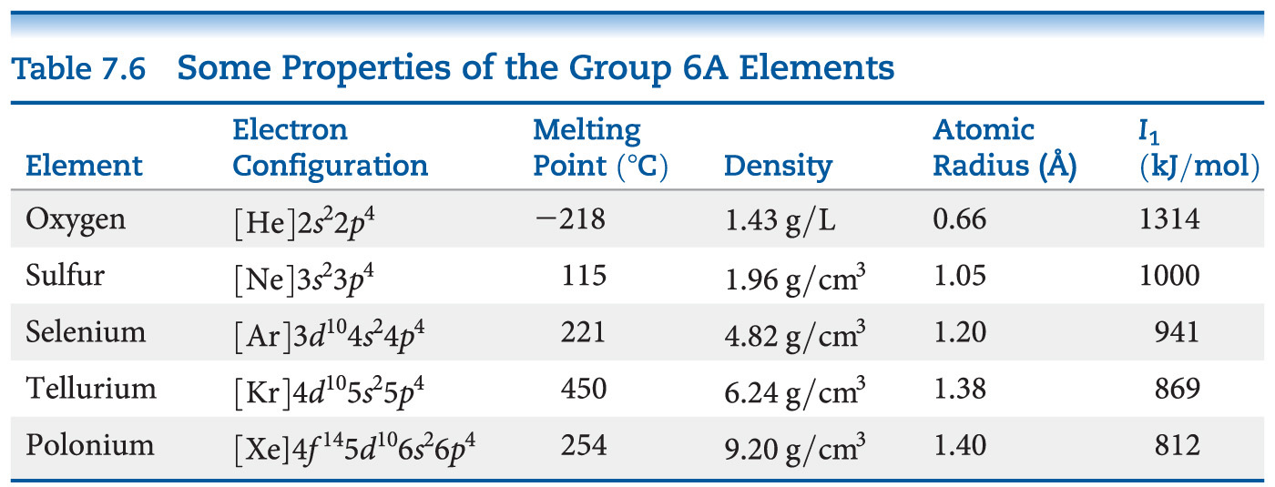
Group 6A—Increasing in Metallic Character down the Group
Oxygen, sulfur, and selenium are nonmetals.
Tellurium is a metalloid.
The radioactive polonium is a metal.

Slide 44
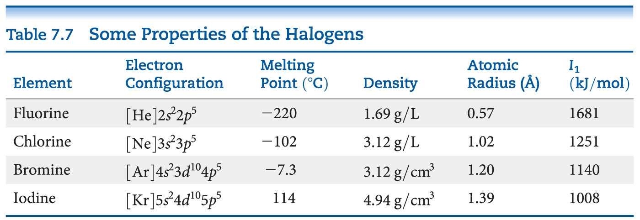
Group 7A—Halogens
The halogens are typical nonmetals.
They have highly negative electron affinities, so they exist as anions in nature.
They react directly with metals to form metal halides.

Slide 45
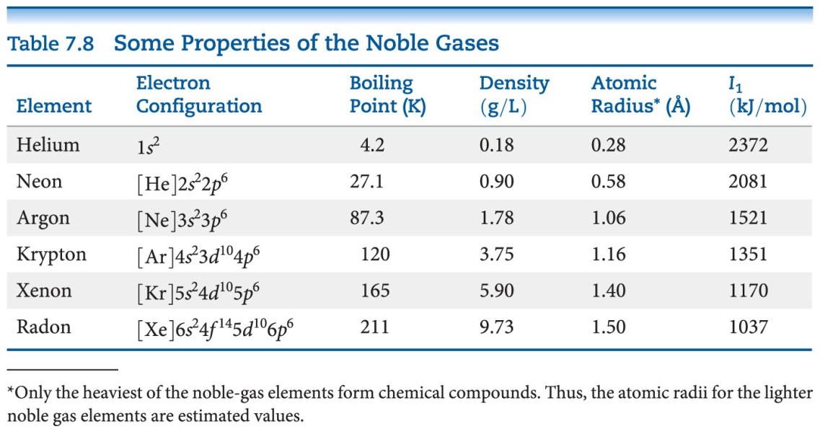
Group 8A—Noble Gases
The noble gases have very large ionization energies.
Their electron affinities are positive (can’t form stable anions).
Therefore, they are relatively unreactive.
They are found as monatomic gases.

